Slide 1
Retinal Image Generation using GAN

Slide 2
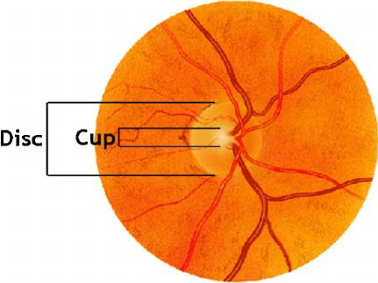
INTRODUCTION
Generative adversarial networks (GANs) are a family of unsupervised machine learning algorithms that have demonstrated their merits through generating synthetic images and solving image-to-image translation problems in natural image domain.
Digital retinal images are widely used for detection of eye diseases, such as glaucoma and diabetic retinopathy. Early detection and treatment for these diseases can prevent blindness.

Slide 3
PROBLEM STATEMENT
The scarcity of digital fundus image data in medical field needs to be sorted out for future research and retinal image analysis.
In the conventional methods, they only focus on vessel segmentation to create retinal images which makes the optic cup and disc part blurry and unsmooth.

Slide 4
LITERATURE SURVEY

Slide 5
1. Retinal image synthesis from multiple‑landmarks input with generative adversarial networks - Yu, Z., Xiang, Q., Meng, J. et al. BioMed Eng Online (2019)
A multiple-channels-multiple-landmarks (MCML) method is proposed using pix2pix model.
Two types of GANs were implemented in this work for comparison studies. One is the Pix2pix model that learns a generator from an image A to an image B.
The other model is Cycle-GAN, which is good at realizing image-to-image translation tasks by unpaired datasets.
The Main idea is to try different generators networks such as U-net, resnet and resU-net along with patchGAN as discriminator to see which combination provides better results.

Slide 6
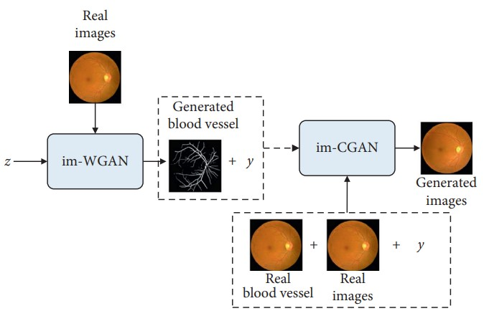
2. Guo, Jifeng & Pang, Zhiqi & Yang, Fan & Shen, Jiayou & Zhang, Jian. (2020). Study on the Method of Fundus Image Generation Based on Improved GAN. Mathematical Problems in Engineering. 2020.
Combined GAN(Com-GAN) is used, which can generate both normal fundus images and fundus images with hard exudates.
In the first stage, an image segmentation technique is used to segment a vascular tree.
More vascular trees are created using im-WGAN.
In the second stage, vascular tree segmented from the real image and the corresponding fundus image, input – output pair is formed to train the im-CGAN .
Based on the expanded vascular tree image set, the trained im-CGAN generator is then used to generate a complete fundus image pair.

Slide 7
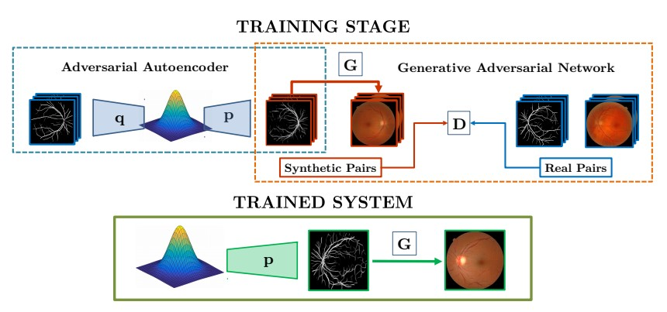
3. Costa, Pedro & Galdran, Adrian & Meyer, Maria & Niemeijer, Meindert & Abràmoff, Michael & Mendonça, Ana & Campilho, Aurélio. End-to-end Adversarial Retinal Image Synthesis, IEEE Transactions on Medical Imaging. (2017).
A generative model is trained to maximize a loss function provided by a second model attempting to classify its output into real or synthetic.
The pair (p, q) is an adversarial autoencoder trained to reconstruct retinal vessel maps.
The pair (G, D) is a Generative Adversarial Network(CGAN) trained to generate color retinal images out of vessel maps.
Once the model is trained, the system can generate a new retinal image and an associated vessel map. The only required input is sampling a distribution p, which is enforced to follow a simple multi-dimensional Gaussian distribution during training by means of an adversarial loss.

Slide 8
4. Fundus Image Enhancement Method Based on CycleGAN - Q. You, C. Wan, J. Sun, J. Shen, H. Ye and Q. Yu 41st Annual International Conference of the IEEE Engineering in Medicine and Biology Society (EMBC), 2019
Cycle-CBAM, based on CycleGAN to realize the migration from poor quality fundus images to good quality fundus images is proposed and it also restore the color of the blurry area for the blurry fundus image.
5. Lorenza Bonaldi, Elisa Menti, Lucia Ballerini, Alfredo Ruggeri, Emanuele Trucco Automatic Generation of Synthetic Retinal Fundus Images: Vascular Network, Procedia Computer Science,Volume 90,2016.
The proposed approach consists of a learning phase and a generation phase.In the Learning phase, data describing vascular morphology and texture are collected from annotations of real images. In the generation phase, the models obtained are used to create synthetic vascular networks.

Slide 9
PROPOSED METHODOLGY
The proposed method is to synthesize color fundus images from a combination of vessel tree, optic disc, and optic cup images using pix2pix model.
Fundus images will be segmented using a pre-trained unet model to obtain vessel images.
Optic cup, optic disc and vessel images are fused to obtain fused RGB images.
A numpy File is created using Fused images as source image and corresponding fundus image as target.
In GAN Model, Generator will be created using unet architecture and a patchGan Discriminator.
After training the GAN Model, a GUI is created using tkinter to display generated retinal images.
SSIM and PSNR will be used as evaluation measure (These measures are used to compare Original image and generated image) .

Slide 10
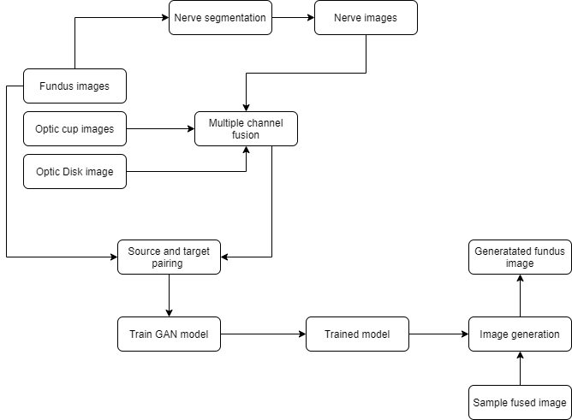
SYSTEM DESIGN

Slide 11
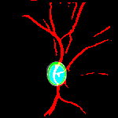
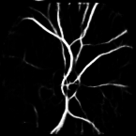


EXPERIMENTAL RESULTS
Optic Cup
Optic Disc
Vessel image
Fused Image

Slide 12
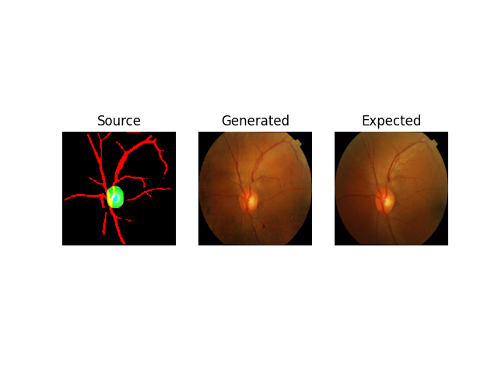


Slide 13
CONCLUSION
In this work, I proposed a method based on GANs to synthesize color fundus image from a combination of vessel, optic disc, and optic cup.
Segmenting vessel images and then fusing them with optic cup and optic disc to produce fused image
Fused Image and Fundus image pair is formed and given to a pix2pix GAN Model to obtain synthetic fundus images.
The results demonstrate that we were able to preserve the vessel , optic cup and disc shape also provides a better PSNR value compared to single vessel method.
The Limitations while performing this project is that we couldn’t improve the SSIM value of fundus image compared to single vessel method which results in diminished visual quality.

Slide 14
REFERENCES
Yu, Z., Xiang, Q., Meng, J. et al. Retinal image synthesis from multiple-landmarks input with generative adversarial networks. BioMed Eng OnLine 18, 62 (2019).
Guo, Jifeng & Pang, Zhiqi & Yang, Fan & Shen, Jiayou & Zhang, Jian. (2020). Study on the Method of Fundus Image Generation Based on Improved GAN. Mathematical Problems in Engineering. 2020.
P. Costa et al., "End-to-End Adversarial Retinal Image Synthesis," in IEEE Transactions on Medical Imaging, vol. 37, no. 3, pp. 781-791, March 2018, doi: 10.1109/TMI.2017.2759102.
Q. You, C. Wan, J. Sun, J. Shen, H. Ye and Q. Yu, "Fundus Image Enhancement Method Based on CycleGAN," 2019 41st Annual International Conference of the IEEE Engineering in Medicine and Biology Society (EMBC), 2019, pp. 4500-4503, doi: 10.1109/EMBC.2019.8856950.
Lorenza Bonaldi, Elisa Menti, Lucia Ballerini, Alfredo Ruggeri, Emanuele Trucco Automatic Generation of Synthetic Retinal Fundus Images: Vascular Network, Procedia Computer Science,Volume 90,2016.https://doi.org/10.1016/j.procs.2016.07.010.
D. Nie, R. Trullo, C. Petitjean, S. Ruan and D. Shen, Medical image synthesis with context-aware generative adversarial networks, Dec. 2016, [online]
S. Fiorini, L. Ballerini, E. Trucco and A. Ruggeri, "Automatic generation of synthetic retinal fundus images", Proc. Eur. Italian Chapter Conf., pp. 41-44, 2014.

